Slide 1

Introduction to Database Systems
DBS211
Normalization (UNF to 1NF)

Slide 2
Week 9
Introduction to Normalization: UNF, 1NF
Lab 8 due Monday July 15th @ 11:59pm
Quiz 7 will take place in Friday’s class
Group Project Milestone 1 due Friday July 12th @ 11:59pm

Slide 3
What is Normalization?
Normalization is rules for designing a database to reduce data redundancy and improve data integrity
There are 5 normal forms. Getting a database to 3rd normal form is sufficient, 4th and 5th normal form are overkill
Normalization Rules:
Eliminates redundant data
Reduces modification anomalies
Insert anomalies
Deletion anomalies
Update anomalies
Ensures dependences are logical

Slide 4
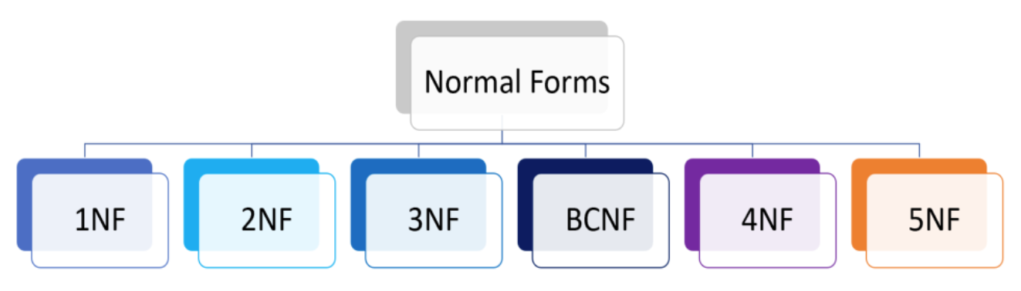
Why Normalize Data?
It is essential when dealing with large amounts of data
It allows us to organize data so it is free from redundancy, minimize data modification errors, and simplify query building
It can improve workflow, increase security, and decrease costs

Slide 5
Advantages of Data Normalization
Improved Data Organization – The database will be structured in a logical way
Data Consistency – Normalization ensures data consistency across all tables, improving workflow
Reduces Redundancy – Helps with database speed, reduces storage, and increases data processing time
Cost Reduction – the above benefits help to reduce the costs of the database.
Increased Security – Normalization requires that data is more accurately located and better organized, thus security is increased

Slide 6
Problems Encountered Without Normalization
If normalization steps are not taken, data redundancy will be a huge issue that will lead to a ton of extra storage requirements
This will also cause an abundance of insertion, update, and deletion anomalies
EmployeeNumber | Name | Department | Head of Department | Extension
100123007 | Harry Potter | Department of Magical Law Enforcement | Hermione Granger | 1111
100123457 | Hermione Granger | Department of Magical Law Enforcement | Hermione Granger | 2222
100123458 | Ron Weasley | Department of Magical Accidents and Catastrophes | Jacob Boom | 3333
100123459 | Rubeus Hagrid | Department for the Regulation and Control of Magical Creatures | Atticus Nute | 4444

Slide 7
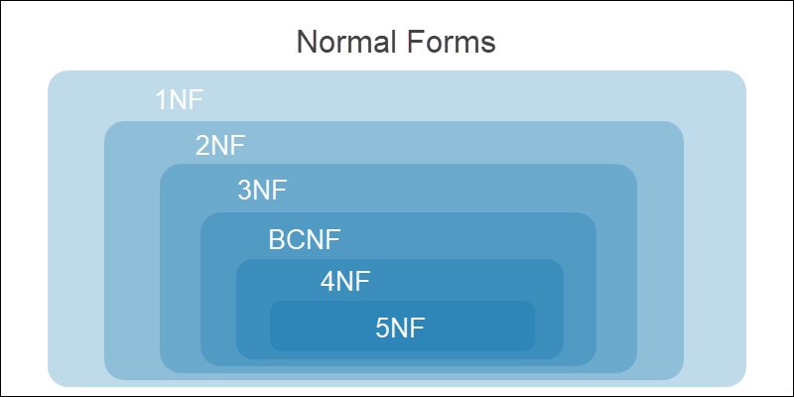
Normalization

Slide 8
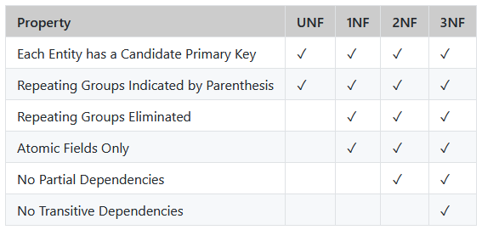
Normal Forms

Slide 9
Definitions
Atomic Fields - An atomic value is an instance of one of the built-in atomic data types
Partial Dependencies - Partial dependency occurs when one primary key determines some other attribute/attributes.
Transitive Dependencies - transitive dependency occurs when some non-key attribute determines some other attribute

Slide 10
Unnormalized Data
Unnormalized data is also known as UNF or 0NF, sometimes also referred to an unnormalized relation or non-first normal form
It is a database data model which does not meet any of the rules od database normalization
Database systems that support UNF are often called non-relational or NoSQL databases
Unnormalized should not be confused with denormalization
Denormalization is the process of adding precomputed redundant data to an otherwise normalized relational database to improve read performance

Slide 11
1st Normal Form
1st Normal Form Rules:
The data is in a database
One or more column is a primary key to uniquely identify each record
Each column contains atomic values, and there are no repeating groups of columns
B
C
A
 | Orders
PK | OrderID
FK | CustomerID
 | ProductID1
 | ProudctID2
 | ProductID3
 | OrderDate
 | OrderTotal
 | Orders
PK | OrderID
FK | CustomerID
 | OrderDate
 | OrderTotal
 | OrderedItems
PK | OrderedItemsID
FK | OrderID
FK | ProductID
 | Quantity
 | UnitPrice
 | Orders
PK | OrderID
FK | CustomerID
FK | ProductsID
 | OrderDate
 | OrderTotal

Slide 12
1st Normal Form
Orders sample data of table B
OrderID | CustomerID | ProductID1 | ProductID2 | ProductID3 | OrderDate | OrderTotal
1 | 1 | 34 | 23 | 12 | 2022-01-12 | 503.00
2 | 2 | 23 | 1 | 11 | 2022-09-15 | 1940.98
3 | 3 | 11 | NULL | NULL | 2022-08-24 | 90.12
4 | 4 | 56 | NULL | NULL | 2022-11-05 | 724.45
5 | 5 | 3 | 45 | 12 | 2022-11-25 | 129.21

Slide 13
Database Definition Language (DBDL)
DBDL is a computer language used to create and modify the structure of a database and database objects like views, tables, schemas, etc.
Syntax:
TABLE_NAME [key_field, field1, field2, FK field4, (field5, field6)… fieldn]
The name of the table is uppercase (all capital letters)
Primary key is underlined or PK is placed in front of the field name
Foreign key is underlined and FK is placed in front of the field name
Round brackets are used to distinguish groups of related data that may result in repeating groups

Slide 14
Database Definition Language (DBDL)
Example:
STUDENTS [studentid, firstname, lastname]
FACULTY [facultyid, firstname, lastname]
COURSES [courseid, corusename, FK facultyid]
STUDENT_COURSES [FK studentid, FK courseid]

Slide 15
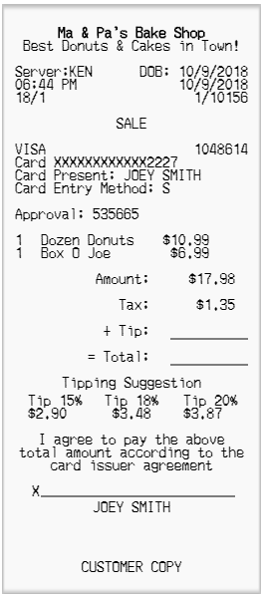
Bake Shop Example
Bake Shop – Not a franchise so there is likely only one location
Server – The server's name is Ken, not something we will focus on
Receipt - the receipt itself is an entity and a good candidate to start with
Products - this person purchased some donuts and a box of coffee
Customer – In this case, customers are likely anonymous and not really needed

Slide 16
Translate to DBDL
RECEIPT [receiptID, company_name, purchase_date]
RECEIPT [receiptID, company_name, purchase_date, employee_id, server_name]
RECEIPT [receiptID, company_name, purchase_date, employee_id, server_name, product_name, quantity, unit_price]
RECEIPT [receiptID, company_name, purchase_date, employee_id, server_name, product_name, quantity, unit_price, taxRate]
RECEIPT [receiptID, company_name, purchase_date, employee_id, server_name, product_name, quantity, unit_price, taxRate, payment_method, cCardNum, cCardName, ApprovalCode]
RECEIPT [receiptID, company_name, purchase_date, employee_id, server_name, product_name, quantity, unit_price, taxRate, payment_method, cCardNum, cCardName, ApprovalCode, isSigned]

Slide 17
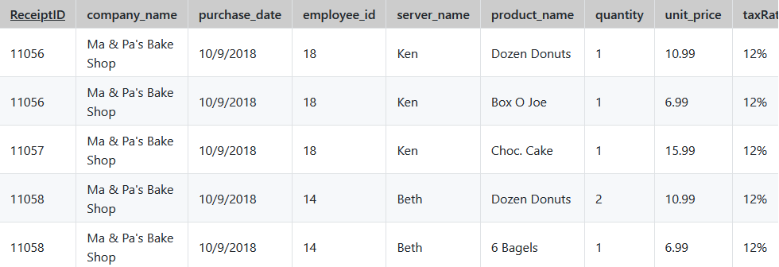
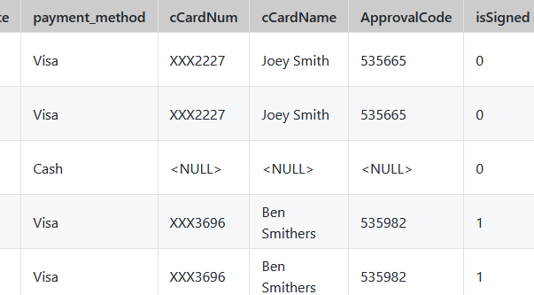
Repeating Groups
Repeating groups are a group of repeating fields (columns) will have values repeated many times within the rows of data

Slide 18
Completed UNF Solution
RECEIPT [receiptID, company_name, purchase_date,
employee_id, server_name, ( taxRate, product_name, quantity, unit_price, ) payment_method, cCardNum,
cCardName, ApprovalCode, isSigned]

Slide 19
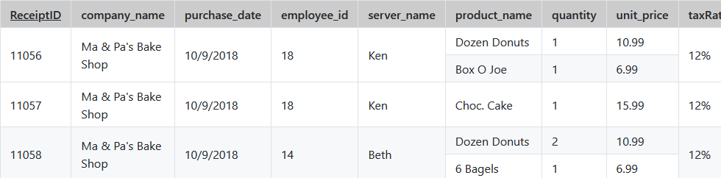
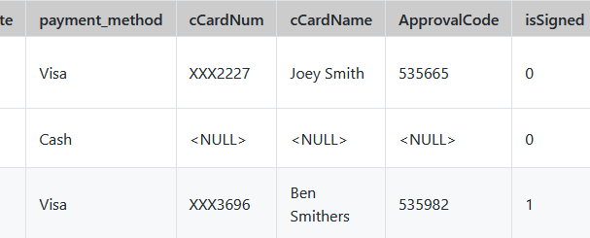
First Normal Form (1NF)
1NF is defined as being a UNF solution in addition to the elimination of Non-Atomic Fields. An atomic field is a field that contains only one value per row. To demonstrate this, let us consider the above table, but follow the principle that the candidate primary key must be unique

Slide 20
First Normal Form (1NF)
RECEIPT[receiptID, company_name, purchase_date, employee_id, server_name, taxRate, payment_method, cCardNum, cCardName, ApprovalCode, isSigned]
RECEIPT_PRODUCT [product_name, quantity, unit_price]
-------------
RECEIPT [receiptID, company_name, purchase_date, employee_id, server_name, taxRate, payment_method, cCardNum, cCardName, ApprovalCode, isSigned]
RECEIPT_PRODUCT [product_name, FK receiptID, quantity, unit_price]

Slide 21
Completed (1NF) Solution
RECEIPT [receiptID, company_name, purchase_date, employee_id, server_name, taxRate, payment_method, cCardNum, cCardName, ApprovalCode, isSigned]
RECEIPT_PRODUCT [productID, FK receiptID, product_name, quantity, unit_price]

Slide 22

Summary
What is Normalization?
Why Normalize Data?
Advantages of Data Normalization
Problems with Normalization
Types of Normal Forms
Unnormalized Data
1st Normal Form
Database Definition Language
Baker Shop Example UNF to 1NF

Slide 23
Week 9
Introduction to Normalization: UNF, 1NF
Lab 8 due Monday July 15th @ 11:59pm
Quiz 7 will take place in Friday’s class
Group Project Milestone 1 due Friday July 12th @ 11:59pm

